Slide 1
Classroom Expectations and Procedures
Mrs. Blair
7th and 8th Grade Math
8th Grade Religion

Slide 2
Respect
What does it mean to you?
Dictionary.com says:
to hold in esteem or honor: to respect your hero.
to show regard or consideration for: to respect someone's rights.
to refrain from intruding upon or interfering with: to respect a person's privacy.

Slide 3
James 1:19-20
“My dear brothers, take note of this: Everyone should be quick to listen, slow to speak and slow to become angry, for man's anger does not bring about the righteous life that God desires.”

Slide 4
How do you show it?
Allow others the freedom to speak without interruption.
Allow others to learn without interruption.
Use appropriate language.
Respect the property of others.
Do not write on others’ papers
Do not write in textbooks
Do not write on desks.
Use positive remarks
The Golden Rule: Do unto others...

Slide 5
Mrs. Blair’s Expectations
Be prepared by bringing all of your materials.
Be an active learner – This is your education. No one can learn for you.
Be respectful of yourself and those around you.
Listen the first time to me and fellow students.
ASK QUESTIONS – even Einstein did.

Slide 6
Beginning of Class
Enter the room with a smile and a greeting.
Quickly get out materials and place homework on desk.
Silently, complete bellwork..
Sharpen your pencil, if needed.
This is not a time to ask questions. If you have a question, write it down in your notebook and raise your hand once I am finished with attendance and the other things I need to complete.

Slide 7
During Lesson
Have paper ready for notes and examples.
Focus on the lesson.
Listen carefully to and follow directions.
Make an honest effort to understand.
Ask sensible questions at an appropriate time by raising your hand.
Stay at your desk unless you need to sharpen you pencil. It is ok to sharpen your pencil during my lesson. You do not have to raise your hand to ask to use the sharpener, simply walk to it and stand. Before sharpening your pencil, wait for me to pause.

Slide 8
During Work Period
First five minutes, silent working on your own.
When working with peers:
Concentrate on your work
Speak quietly
Be respectful
Ask three (3) before me.
Raise your hand to ask questions – DO NOT follow me around the room.
Get supplies you need, sharpen pencil, any other sensible reason to be out of your seat.
At the end of the work period, clean up your area, return supplies borrowed, turn in completed work as directed.

Slide 9
During Closing
Write a thoughtful, detailed answer to the Question of the Day (QOD)
Use mathematics language.
Use complete sentences and correct punctuation. Spell the best you can.
Be ready to share your answer.
Periodically, QOD will be taken for a grade.

Slide 10
Transitions
Executed quickly
Executed silently
The more time wasted on transitions, the less we get accomplished in class, the more you have for homework...See how it works?

Slide 11
Finished Early?
Help others who are still working (This does not mean giving them the answers!)
Silent read
Work on other homework
Allow others to finish

Slide 12
At The End of Class
I release you; the clock does not.
Clean up your area
Make sure you have all of your materials!!
Straighten up the desks
Exit with a salutation

Slide 13
What is a Standard?
What the teacher must teach
What the student must learn and be able to do

Slide 14
Cooperative Learning
Occurs when you are working with your peers
Expectations:
Concentrate on your work
Everyone participates
Every member brings special talents and knowledge to the group
Use only accountable talk
Speak quietly
Be respectful
Share supplies
Everyone helps to clean up

Slide 15
Accountable Talk
Discuss only the lesson
Discuss the task/assignment
Cooperatively develop a strategy for completing the task
Discuss the required expectations and directions
Discuss how to meet or exceed the expectations
“Mathematics” language

Slide 16
What is Quality Work?
Any work that demonstrates and shows what the student has learned and can do
Quality work reflects the stnadard.
Quality work is:
1. Organized
2. Neat
3. Legible
4. Done according to directions
Quality work always includes labels and a detailed answer

Slide 17
Who Can Assess Your Work?
Teacher, self, or peer
All work is graded fairly based upon the standards and directions.
Self-reflection is completed prior to me assessing your work on major projects or tasks.
Questions to reflect upon:
What went well?
What can be done better?
What can be done next time?

Slide 18
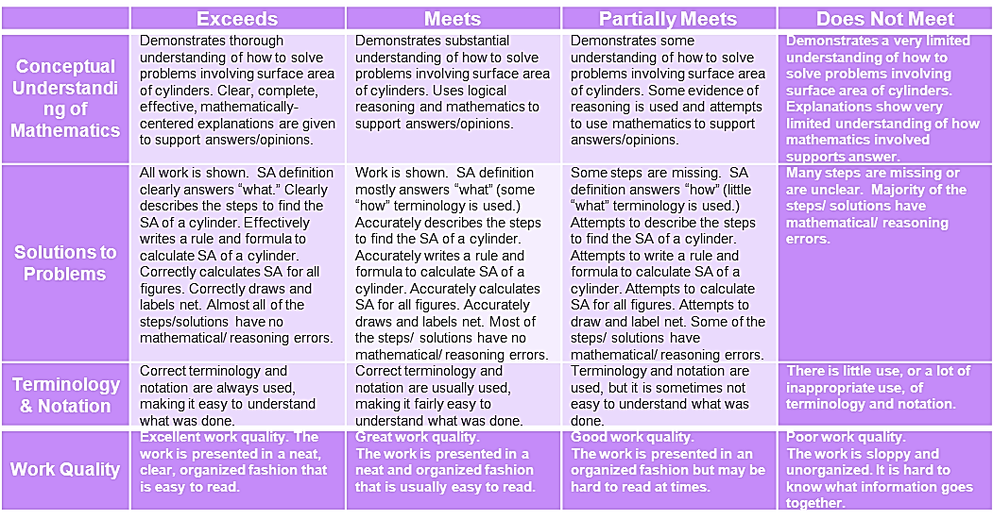
Rubric Example
Project/Task: Cylinder Task

Slide 19
What is Commentary?
Commentary: Written communication that explains how a student did or did not meet a standard.
Commentary:
Explains what can be done the next time to meet the standard
Good Commentary:
Great job Amanda, you met standards because your work shows/ demonstrates that you understand the difference between theoretical and experimental probability. Your answer is thorough and shows your complete thought process.

Slide 20
Guidelines for Bellwork and Question of the Day (QOD)
Two days’ worth of Bellwork and QOD per page.
Write the next two days’ Bellwork and QOD on the back.
At the top of a new page and ½ way on the same page write the date and the lesson objective/title.
For Bellwork, simply solve the problem or answer the question.
For QOD, first write the question, followed by your answer.
Use labels, complete sentences, and details in your answers.

Slide 21
Guidelines for Taking Notes
All notes from the lesson go in the math notes section.
Mrs. Ritter does not want to find math notes amongst your science papers.
At the top of a new page, write the date and lesson objective/title.
Notes must be detailed and thorough

Slide 22
Weighted Averages
Grades are based upon weighted averages as outlined below:
Class work – 30%
Homework – 15%
Assessments (tests and projects) – 30%
Quizzes – 20%
Exam (Semester and End of Course) – 5%

Slide 23
Homework
Homework is practice for what you have learned in class.
My expectation is that you will try your best on your homework. You cannot succeed in math or religion without completing your homework.
Unless otherwise stated, homework is due the day after it is assigned.
Homework (unless it is a major task/project not finished in class) is for credit only.
All assignments are to be written in agenda daily.

Slide 24
Homework Completion
If you complete it according to expectation, you earn a 100% for the assignment.
If work is shown according to expectation and the majority of the problems are complete (over 50%), you will receive 75% for the assignment.
If only answers are given or less than 50% of the assignment is complete, you will receive 50% for the assignment.
Anything less, you will receive 0%.

Slide 25
Late Fee
Any work not turned in on the date it is due, except absent work, can still be turned in.
You are expected to still complete the assignment.
Late fee = 10% per day late up to the 5th day. After that, you will receive 50% credit.
Fifty percent is the minimum you can receive for any late assignment regardless of how late it is.
Fifty percent is better than zero percent...

Slide 26
Absent Work
You will have one day for every day of absence to turn in your missed work.
Ex. If you are home sick for three days, you have three school days to return any work missed.
After the absent deadline, you will be assessed the 10% per day late fee.
The only exception is long-term projects as the deadline is given well in advance. These are due the day you return to school
If you are absent more than one day, please ask a sibling or Mom or Dad to pick up your homework.

Slide 27
Class work
Participation in class activities and class assignments are important to informally assess student learning and understanding.
All students are expected to participate in class.
Students will receive a participation grade on a daily basis.
Participating in note-taking is a part of the class experience.
Students are expected to take notes in their workbooks or 3-ring binder.
Students are responsible for any work missed during the instructional day.

Slide 28
Participation Guidelines
Think about how well you participated in class the week.
Answer the following questions, as they will help you give yourself a fair participation grade for the week.
Did you participate in discussions?
Did you come prepared to class, having done your homework, so that you could ask questions?
Did you ask questions when you didn’t understand?
Did you listen to others?

Slide 29
Participation Guidelines con’t
Give yourself a 5 if you answered yes to all of the questions. Hooray for you!
Give yourself a 4 if you answered yes to most of the questions.
Give yourself a 3 if you answered yes to a few of the questions.
If you answered no to several of these, give yourself a 2, rethink your role in this class, and talk to Mrs. Blair.

Slide 30
Assessments
Projects:
Students will be given projects periodically throughout the semester.
Students will receive information on these projects as the date arises.
Students will be given ample time to complete projects, in some cases extra class time.
Students will be graded on a rubric, which will communication the expectations of the project and assess specific criteria of the assignment.

Slide 31
Assessments con’t.
Tests
A test will be given at the conclusion of every Unit.
Students will have an in class review the day before the test, which will include sample test questions.
Written tests should be completed independently.
Using notes, talking, or cheating during a test is NOT allowed.
If a student is found doing such things, he/she will receive a 0% on the test and cannot make up the test.
NOTE: All Assessments will stay inside of the classroom in the students’ portfolio.

Slide 32
Quizzes
A quiz will be given periodically during a unit of study.
Quizzes are used to assess student’s current performance to inform me of what we as a class or individual students need to review prior to the final test.
NOTE: All Assessments will stay inside of the classroom in the students’ portfolio.

Slide 33
Grading Scale
Points will be averaged and letter grades assigned based upon:
95-100% = A
93-94% = A-
91-92% = B+
87-90% = B
85-86% = B-
83-84% = C+
80-82% = C
78-79% = C-
76-77% = D+
72-75% = D
70-71% = D-
Below 70% = F

Slide 34
Portfolio
A portfolio is a collection of student work, measuring progress over time.
At the end of each unit of study, you will organize your portfolio and celebrate the progress that you have made so far in the year.

Slide 35
Revising Work
For certain assignments, you will be offered a chance to revise your work.
Revising work means to correct an assignment which does not meet standards.
Revising work is much more than simply finding the correct answer.
Sometimes the best way to truly understand something is to correct your mistakes.

Slide 36
Test Corrections/Revisions
On any and all tests with a score of 85% or below, students may do test corrections, earning a max score of 90%. Applies to all Jr. High Classes
Proper test corrections include:
Question written out completely
Correct answer written out completely
An explanation of the new answer- why is it correct? Or what was incorrect about your original thinking? **Other acceptable formats may be provided by individual teachers for particular tests or content **
Essays completely rewritten (essays do not need an explanation)
Parent signature
Corrections must be turned in the day after the test is returned.
All test corrections must be done properly; if, they are to be graded.

Slide 37
Test Corrections/Revisions con’t
Corrections are available on tests, quizzes and performance assessments in math and religion, not long-term projects.
Note 1: Even if you only need to do two corrections to get your score up to a 90%, you must do ALL missed questions for your test to be re-graded.
Note 2: If you only missed 1 point on an essay, you are still required to re-write the whole thing and fix it to make it better!!!

