Slide 2
List as many things as you can think of that are purple. And as many "meanings" for purple (what does purple represent?) as you can think of.
Purple has many meanings. During Lent purple is meant to remind us of the need to repent of our sins, but as the color for royalty it is also meant to remind us that Christ is king.

Slide 3
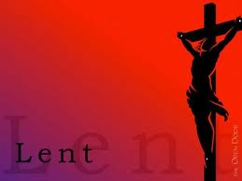
Lord as we begin this season of lent help us to recognize the importance of your son's passion and death. May these forty days of devotion, lead us deeper into communion with you. We ask this through Christ, our Lord. Amen.

Slide 4
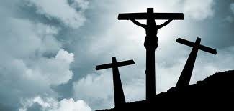
Where does the word "lent" come from? What is the Latin word for lent?
As you watch this video, look for the answers to these questions as you complete the "What Does Lent Mean?" worksheet.
What Does Lent Mean - YouTube [freecorder.com].mp4

Slide 5
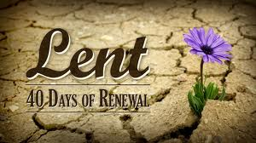
In 3 minutes, list as many things as you can that you are thankful for on the ws. titled "The 40 Days of Lent." They can be the obvious (material things) to the less obvious (intangible things).
Come up to the board and write two of the items from your list. As others are adding to our list, you may use their ideas to add to your list until you fill up all 40 items.

Slide 6
·List references in the bible you remember that involve numbers. Any number.
·Circle any of those that involve the number 40.
As we view the video "40 in the Bible," complete the tree map. Include a picture and summary for each story.
The Number 40 in the Bible (and Lent) - YouTube [freecorder.com].mp4

Slide 7
Please recite the Confiteor
I confess to almighty God
and to you, my brothers and sisters,
that I have greatly sinned
in my thoughts and in my words,
in what I have done
and in what I have failed to do,
through my fault,
through my fault,
through my most grievous fault;
therefore I ask blessed Mary ever-Virgin,
all the Angels and Saints,
and you, my brothers and sisters,
to pray for me to the Lord our God.

Slide 8
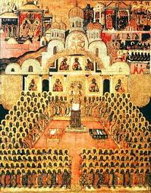
As you view this next video on the history of Lent and complete the graphic organizer, remember what we learned abut the Council of Nicaea as well as what was happening in the Middle Ages.
A Brief History of Lent - YouTube [freecorder.com].mp4

Slide 9
Let us recite the responsorial psalm from today's mass.
R. Be merciful, O Lord, for we have sinned.
Have mercy on me, O God, in your goodness;
in the greatness of your compassion wipe out my offense.
Thoroughly wash me from my guilt and of my sin cleanse me.
R. Be merciful, O Lord, for we have sinned.
For I acknowledge my offense, and my sin is before me always:
"Against you only have I sinned, and done what is evil in your sight."
R. Be merciful, O Lord, for we have sinned.
A clean heart create for me, O God, and a steadfast spirit renew within me.
Cast me not out from your presence, and your Holy Spirit take not from me.
R. Be merciful, O Lord, for we have sinned.
Give me back the joy of your salvation, and a willing spirit sustain in me.
O Lord, open my lips, and my mouth shall proclaim your praise.
R. Be merciful, O Lord, for we have sinned.

Slide 10
Let's read about the story of Jonah and the city of Nineveh. Turn to Jonah 3:1-10.
Bear in mind the signs the people of Nineveh used to show their repentance. As we watch "Ash Wednesday," complete the fill-in the blanks on the worksheet.
Ash Wednesday - YouTube [freecorder.com].mp4

Slide 11
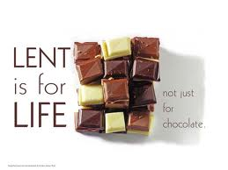
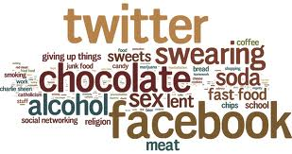
Give up or take on? Or both?
Let's review the poem "Reflection of Fasting" in your Lenten Journal.
Make your Lenten commitment. Reflect upon your commitment as you answer the questions that follow.
Lenten Journal.pdf

Slide 12
The Three Pillars of Lent: Fast, Pray, and Charity or Almsgiving
Last year, I fasted on my weekly (sometimes bi-weekly) mocha. I saved the money I would have spent at my favorite coffee shop and donated it to Amigos for Christ, an organization started at my parish in GA which helps improve the lives of people in South American countries by teaching them how to dig trenches to get clean and safe drinking water.
prayer_ fasting_ and almsgiving_ the three pillars of lent.mp4

Slide 13
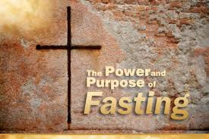
There are two important reasons for fasting:
1) to recognize that all that we have is a gift from God and
2) to build up self-control and resistance to temptation.
Create a mini-poster that would motivate you to resist temptation in the future. In the poster you might include the success you have had living out fasting during the season of Lent.

Slide 14
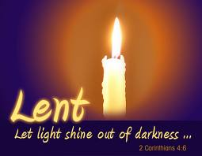
Recall Romans 10:13
"For everyone who calls on the name of the Lord will be saved."
Where does prayer fit into your day?
Complete the schedule of a typical week for you.
Where can you add the second pillar into each of your days such that you call on the name of the Lord everyday?

Slide 15
Bear this in mind as we view this video on Penance and Reconcilliation. As you view the video, complete the Sacrament of Penance and Reconciliation Flow Map.
the sacrament of penance and reconciliation.mp4

Slide 16
·Define the following:
contrition
confession
absolution
reconciliation
penance
·Let's read the parable of the Prodigal Son (Luke 15:11-32.) As we read, think about how each of these terms fits into the story.
·Label each part of the table on your worksheet with each term above.

Slide 17
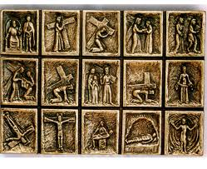
One of my favorite traditions to do during Lent is to attend the "Stations of the Cross" with Jessica, Tony, and my husband. It provides us with time to really focus on Jesus' suffering.
What are the stations of the cross? Where did the idea of retracing Jesus' steps originate?
Complete the Stations of the Cross worksheet as we view this video.
The 14 Stations of the Cross - YouTube [freecorder.com].mp4

Slide 18
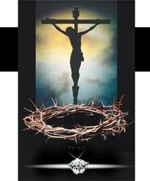
But those were the Romans who persecuted Jesus, that was not me...or do I continually persecute Jesus?
I did not nail his hands to the cross...or do I through my actions?
Bear these in mind as we view this video on Palm Sunday.
Palm Sunday (short film) - YouTube [freecorder.com].mp4

Slide 19
An Examination of Conscience for Young Adults
Responsibilities to God:
Have I gone to Mass on Sunday or have I rebelled and been stubborn about going to Mass?
Did I participate in the Mass or did I daydream?
Have I prayed every day?
Have I read the Bible?
Have I been rebellious toward God and his commands?
Have I misused the name of God by swearing and cursing?
Have I told the Father that I love him for creating me and making me his son/daughter?
Have I thanked Jesus for becoming man, dying for my sin and rising to give me eternal life?
Have I asked the Holy Spirit to help me conquer sin and temptation and to be obedient to God’s commands?
Responsibilities to others and myself:
Have I been rebellious, disobedient or disrespectful to my parents, teachers and those in authority over me?
Have I lied to or deceived my parents or others?
Have I been arrogant and stubborn?
Have I talked back to my parents or those in authority?
Have I gotten angry or nurtured and held grudges and resentments? Have I refused to forgive others? Have I cultivated hatred?
Have I gossiped about others? Have I slandered anyone? Have I told lies about others? Have I mocked or made fun of others?
Have I lied or cheated? Have I stolen anything? Have I paid it back?
Have I been selfish or spiteful toward others? Have I been jealous?
Have I been patient, kind gentle and self-controlled?
When my conscience told me to do something good, did I do it or did I ignore it?
Copyright, Fr. Thomas Weinandy. This resource may be reproduced and distributed free of charge by permission of the author

Slide 21
Attachments
Ash Wednesday - YouTube [freecorder.com].mp4
prayer_ fasting_ and almsgiving_ the three pillars of lent.mp4

